Slide 1

CSC 680 - Project Proposal
LSUS CONNECT

Slide 2
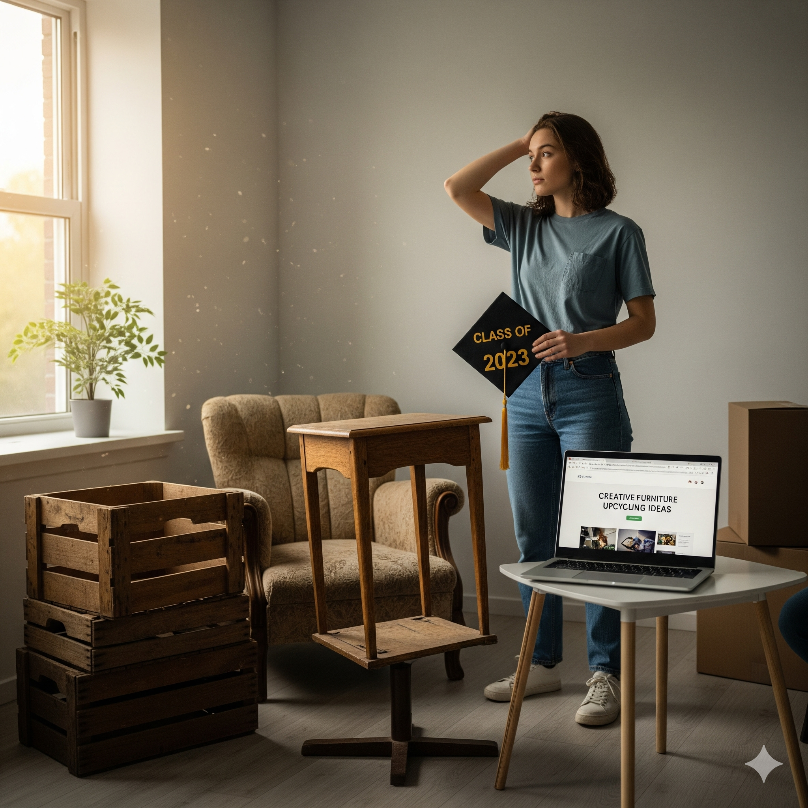
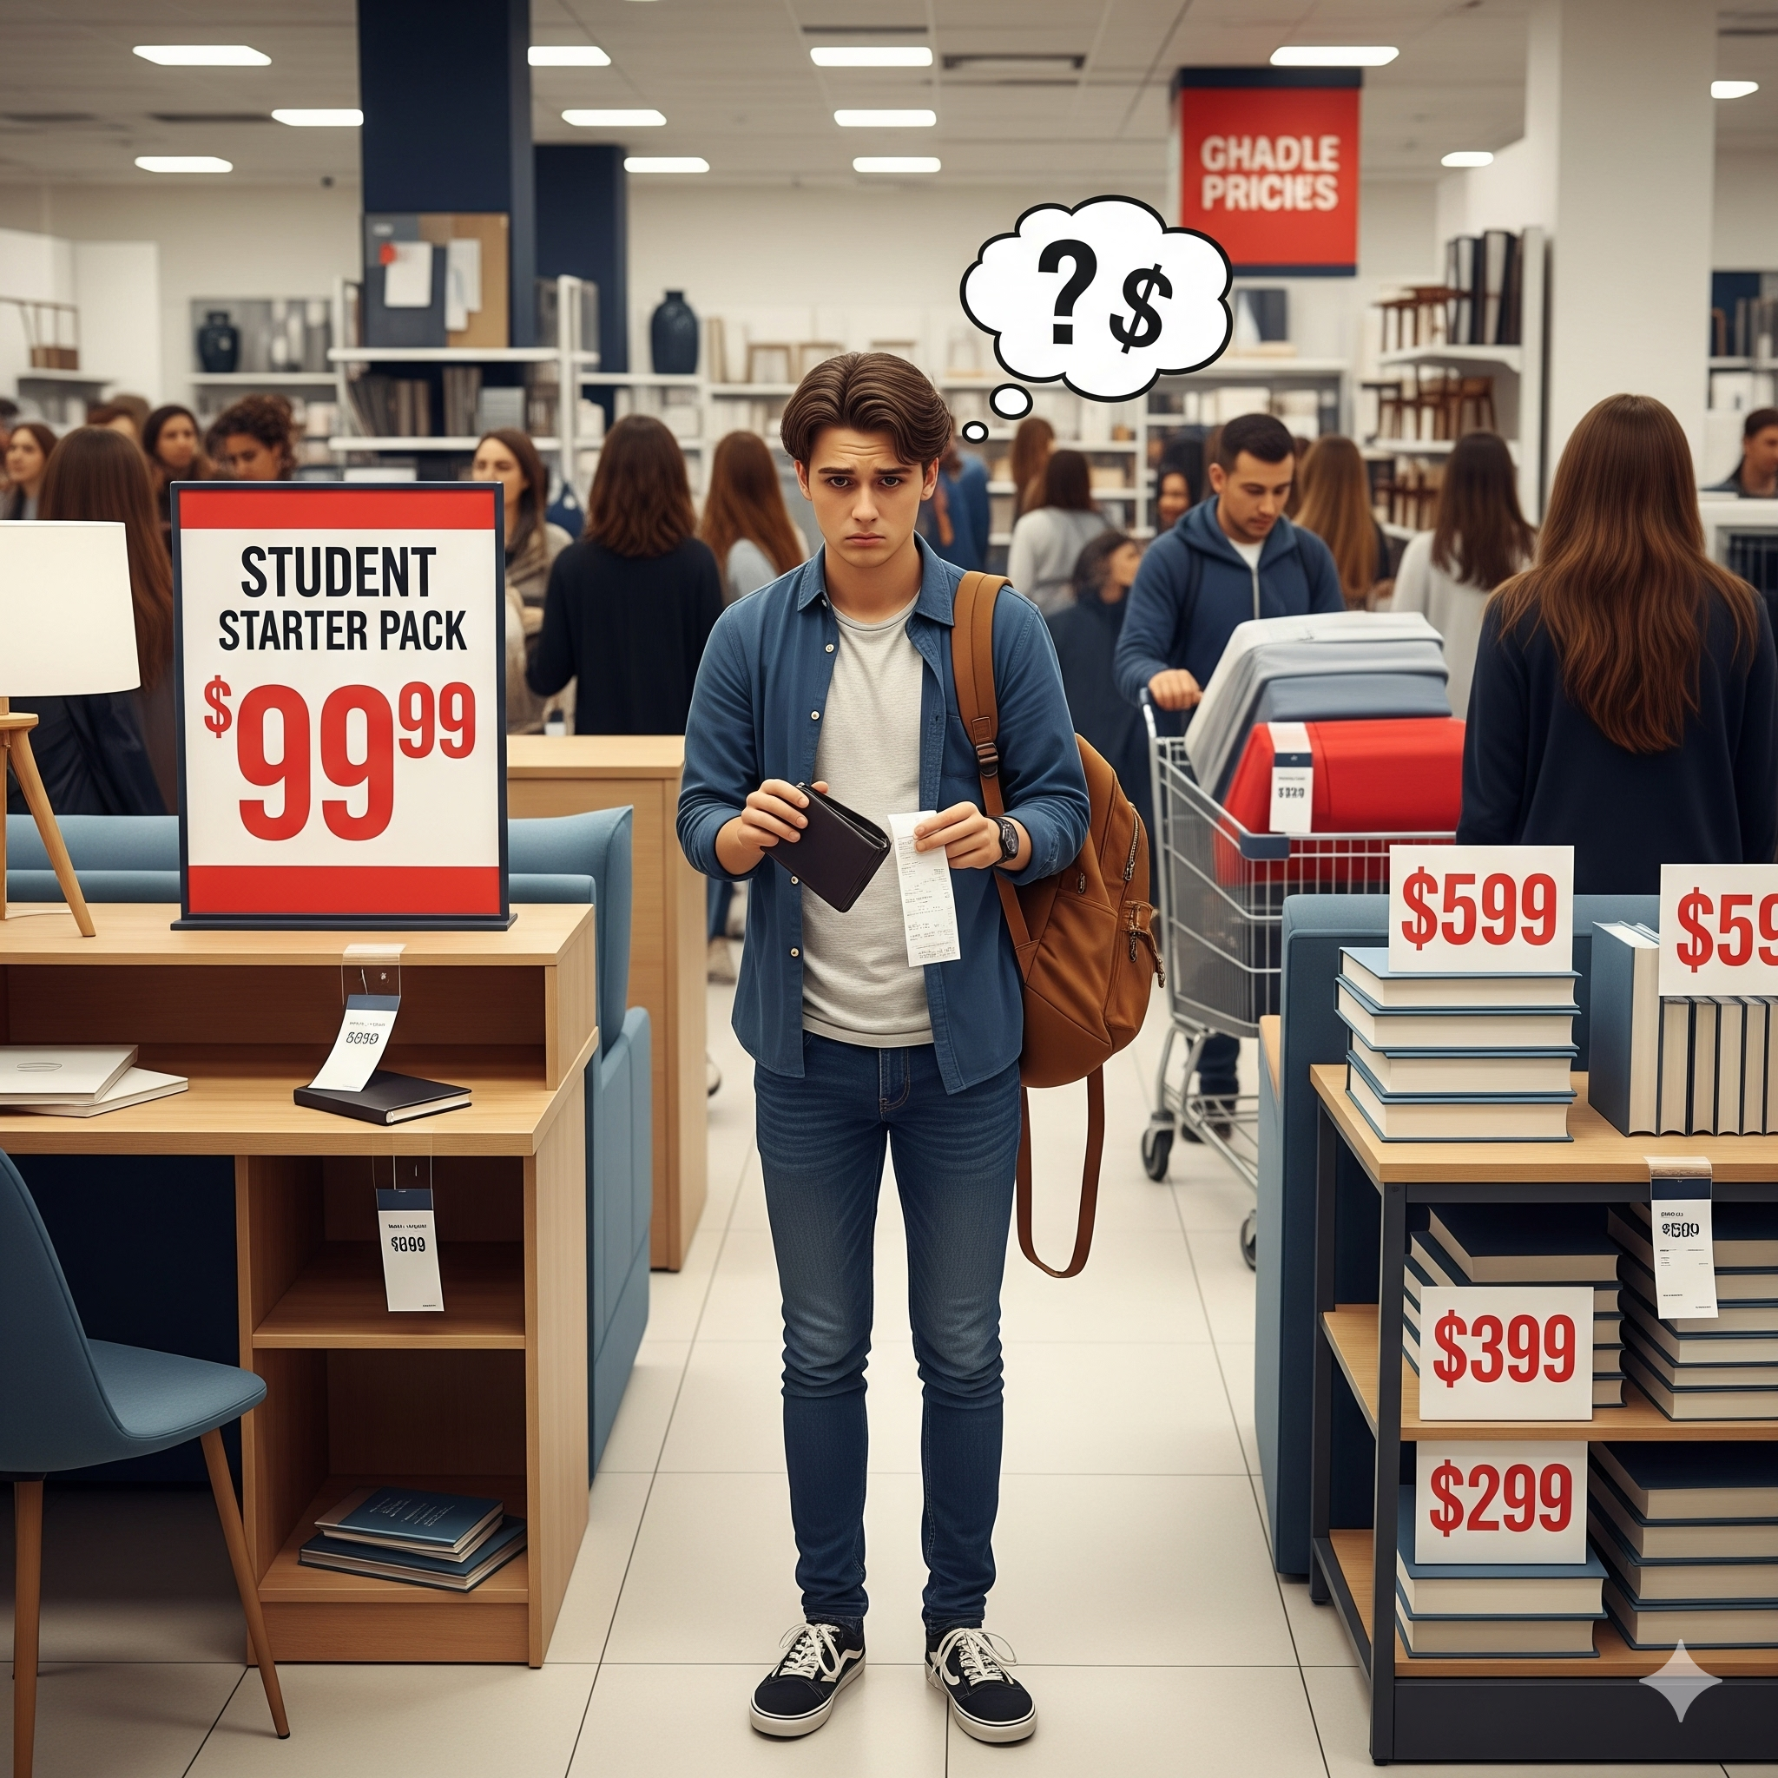
Problem Background:
Graduating students leave behind useful
items: furniture, appliances, books
New/incoming students need affordable
essentials but lack a trusted source

Slide 3

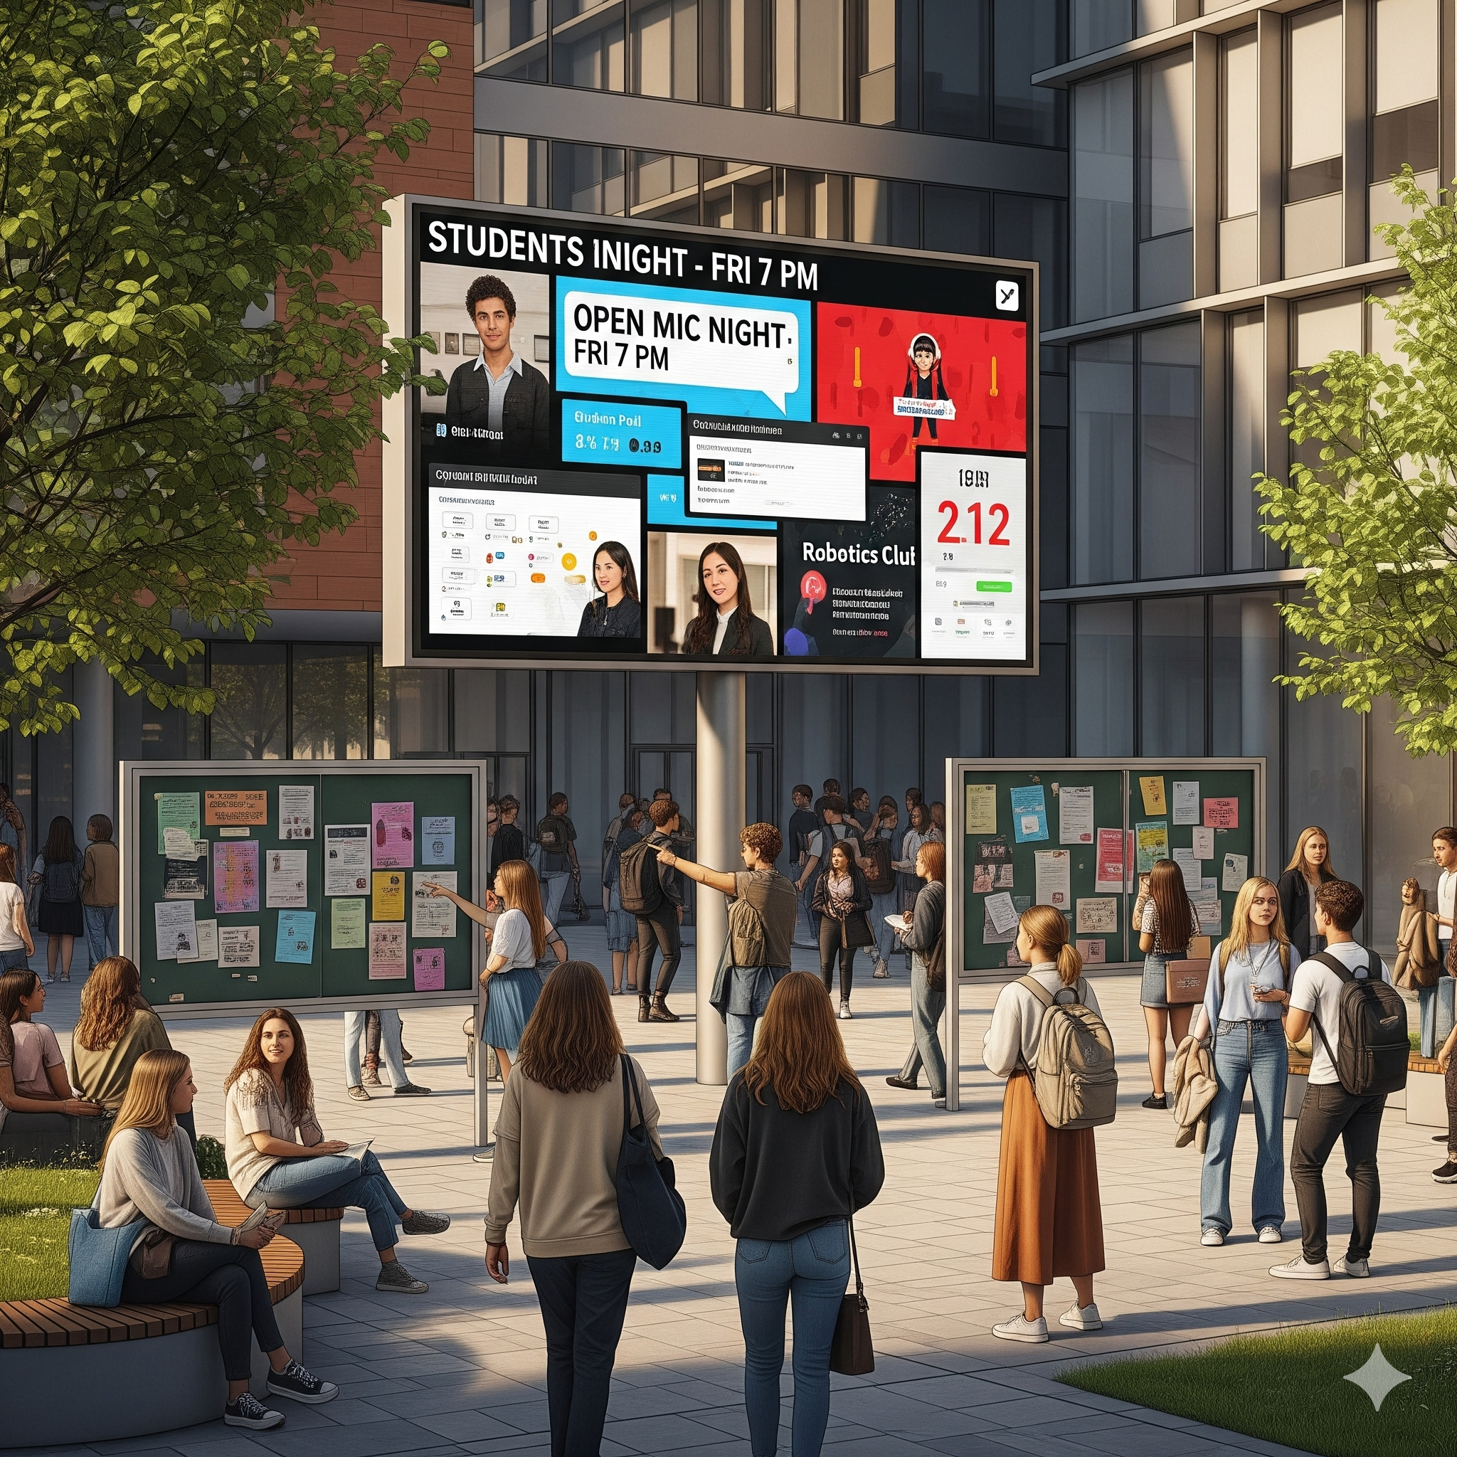
Finding a flat mate or new housing
is a major struggle for students.
students lacking a single place to share
opinions, promote events, or ask queries.

Slide 4
This leads to:
🚫 Wasted resources & unnecessary expenses.
🚫 hard time finding an accommodation.
🚫 Higher risk of scams or unsafe transactions.
🚫 Missed opportunities for community connection.

Slide 5
Solution: LSUS-CONNECT
A campus-only marketplace & social hub.
University email login → trusted, safe, student-only.
Buy, sell, swap, or give away items.
Finding Flat mate, new house or a community
Central place for student Queries.
Built-in chat for direct, secure communication.

Slide 6
Plan:
Web based application
Responsive with mobile and desktop
Developed with MERN Stack
Future collaboration with campus resources

Slide 7
Team
Abid Talukder
Wei Chen
Robert Lovelace
Showrab Bin Habib

